Slide 1
EUROPEAN DIVERSITY DESIGN FOR INCLUSIVE EDUCATION
IO3:
Hardware to support devices’ personalisation for disabled students
2018-1-ES01-KA201-050300

Slide 2
IO3 Personalized input devices
Objective:
To provide students with special needs a personalized device to handle ICT equipment (e.g. computer, tablet, smartphone).
Methodology:
Development of low-cost personalized input devices using 3D printing technology, for example to take over keyboard functions.
arrow keys
enter key
space bar
etc.
Example:
Low-cost push button by CEAPAT: https://youtu.be/GIWTpx9nKFQ

Slide 3
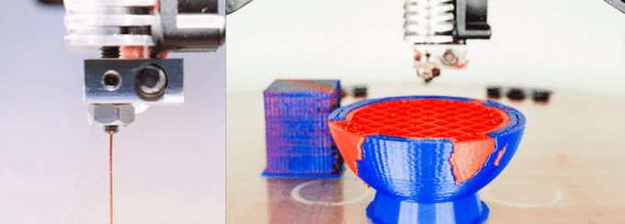
IO3 Personalized input devices
3D printing (technically more correct → Additive Manufacturing):
Relatively cheap way to generate personalized assistive technology devices.
Nowadays, it is widely distributed and accessible to all → compare with the evolution of desktop inkjet printers, or the introduction of the PC.
Source: geeetech.com/blog/

Slide 4
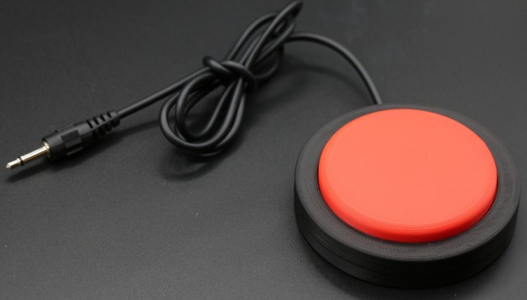
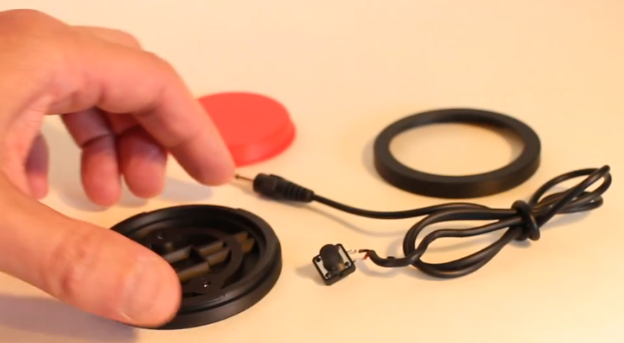
IO3 Personalized input devices
Example: Jelly Bean Switch
3D model is available in the 3D Design Repository
https://www.thingiverse.com/
Thingiverse → Explore: Groups → Search Groups: “assistive” → Assistive Technology: View Group → Things: POPULAR → The adaptable swith by Pole_ergo.
Thingiverse
https://www.thingiverse.com/thing:3086823
https://youtu.be/G_vfFqMYHT8

Slide 5
IO3 Personalized input devices
What do we need?
3D printer and 3D printer material
Design
3D printing Work Flow: from design to 3D printed component
Depending on the design: assembly materials, assembly tools, handy hands (ask help → FabLabs)
3D CAD DESIGN
.STL
FILE
.GCODE
FILE
3D
PRINTING
POSTPROCESSING

Slide 6
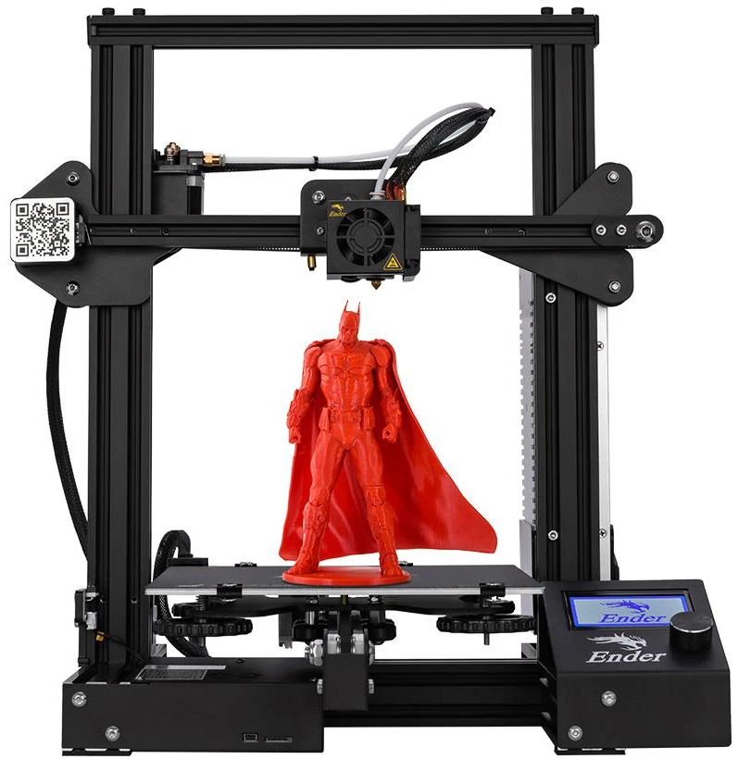
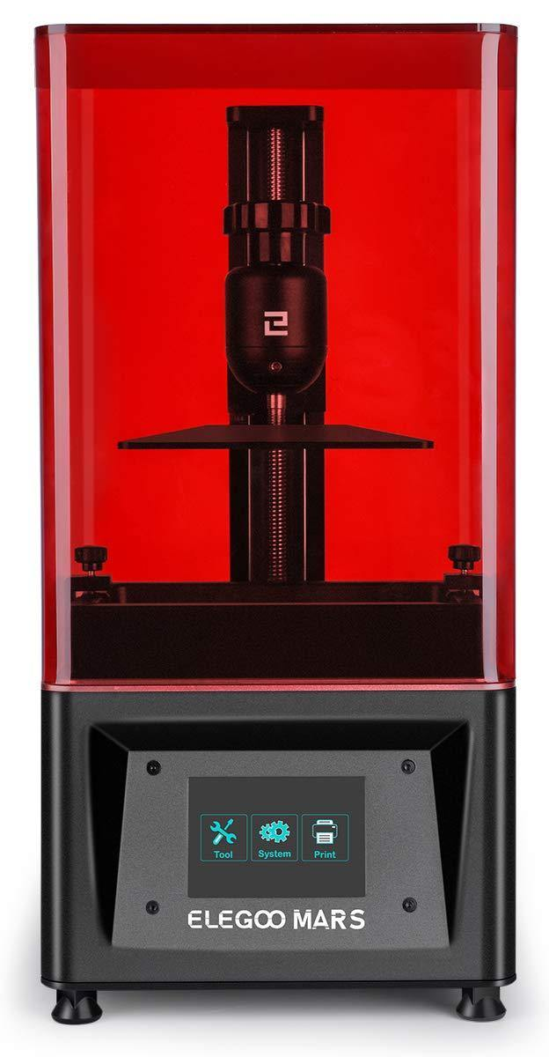
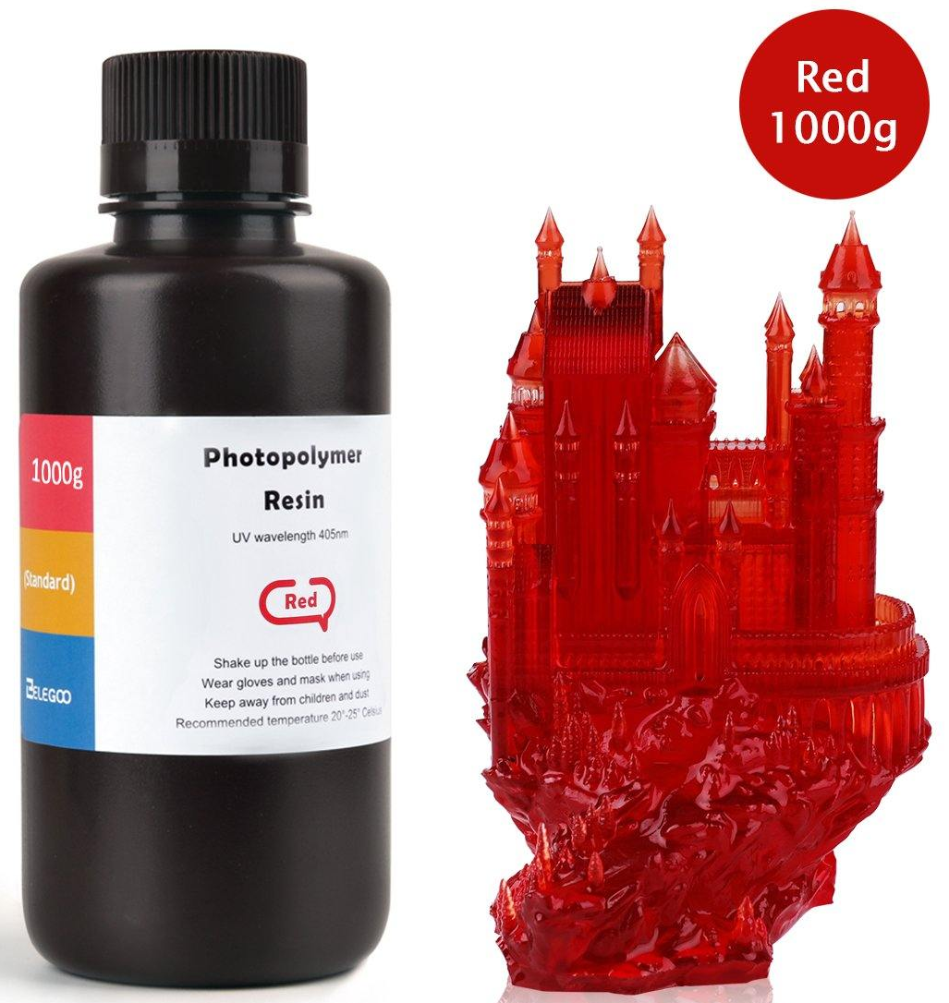
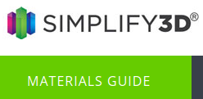
IO3: What do we need?
3D printer and 3D printer material:
Creality Ender 3
Filament: PLA
Elegoo Mars
Liquid Resin
±€ 15 - € 25 / kg
Filament: ABS
±€ 140
±€ 20 - € 30 / kg
±€ 160
±€ 15 - € 25 / kg
https://www.simplify3d.com/support/materials-guide/
Notes:
PLA is a bioplastic: a plastic made from renewable biomass sources. PLA monomer is typically made from fermented plant starch such as from corn, cassava, sugarcane or sugar beet pulp. Jelly Bean base component: +/-20gr. Complete Jelly Bean: +/- 40gr.

Slide 7
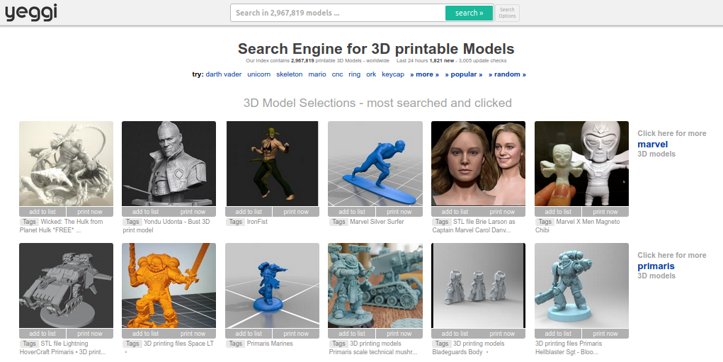
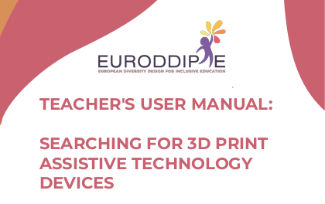
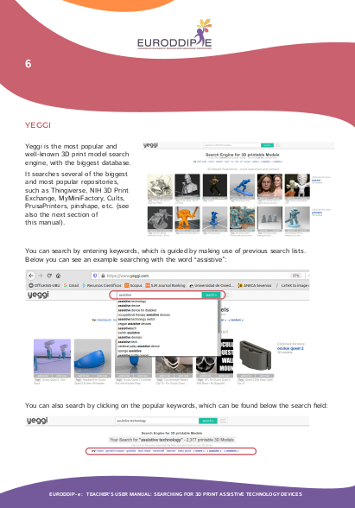
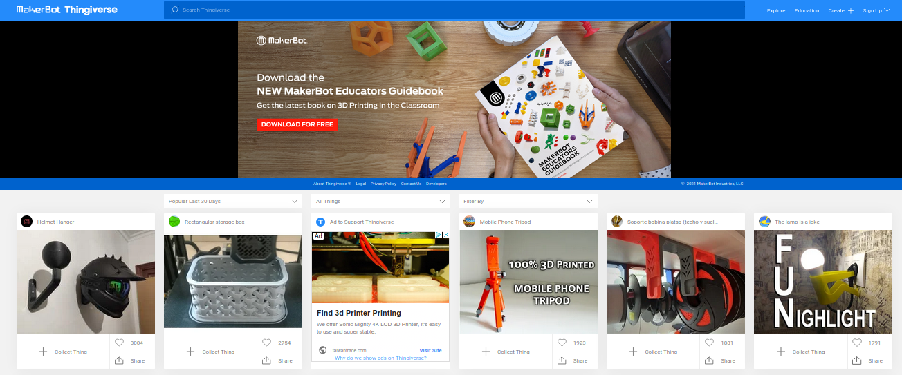
IO3: What do we need?
Design: 3D model search engines and repositories
https://www.yeggi.com/
Available at:
https://euroddip-e.eu/
https://www.thingiverse.com/

Slide 8
IO3: What do we need?
3D printing Work Flow: from design to 3D printed component
3D CAD DESIGN
.STL
FILE
.GCODE
FILE
3D
PRINTING
POSTPROCESSING
3D CAD SOFTWARE
3D PRINTING SOFTWARE
SLICER SOFTWARE
3D PRINTER
FINISHED PRODUCT
Seems complicated?
Search for help!!

Slide 9
IO3: What do we need?
3D printing Work Flow: from design to 3D printed component
Where to search for help?
Internet → self-taught / Do-It-Yourself
Documentation and videos → 3D Printing for Beginners Guide
FabLab
Training sessions/courses
3D CAD DESIGN
.STL
FILE
.GCODE
FILE
3D
PRINTING
POSTPROCESSING

Slide 10
IO3: What do we need?
3D printing Work Flow: from design to 3D printed component
Where to search for help?
Internet → self-taught / Do-It-Yourself
https://all3dp.com/ → The World's #1 3D Printing Magazine for Beginners and Professionals.

Slide 11
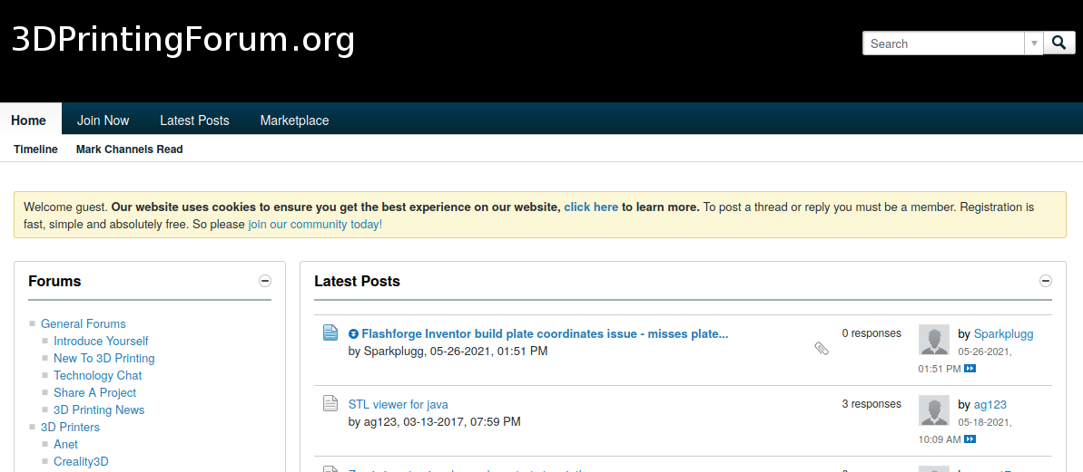
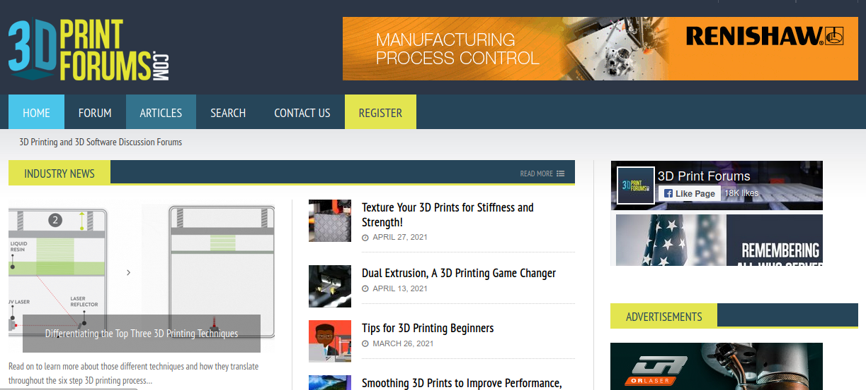
IO3: What do we need?
3D printing Work Flow: from design to 3D printed component
Where to search for help?
Internet → self-taught / Do-It-Yourself
Forums and Discussion Groups: https://www.3dprintforums.com/
https://www.3dprintingforum.org/

Slide 12
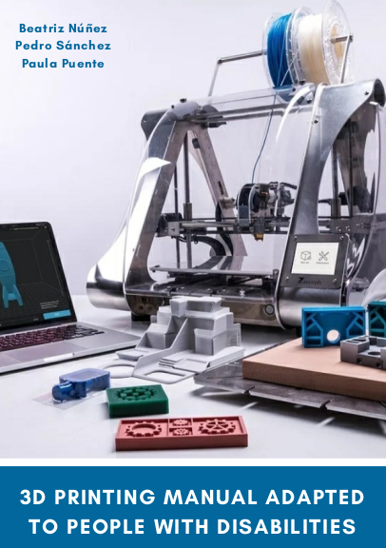
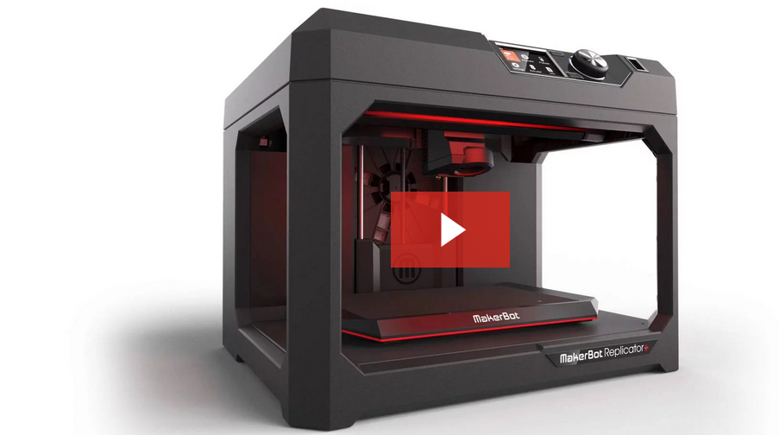
IO3: What do we need?
3D printing Work Flow: from design to 3D printed component
Where to search for help?
Documentation and videos → 3D Printing for Beginners Guide
https://all3dp.com/2/3d-printing-for-beginners-all-you-need-to-know-to-get-started/
Available at:
https://euroddip-e.eu/
https://www.makerbot.com/learn/
https://riubu.ubu.es/handle/10259/5478

Slide 13
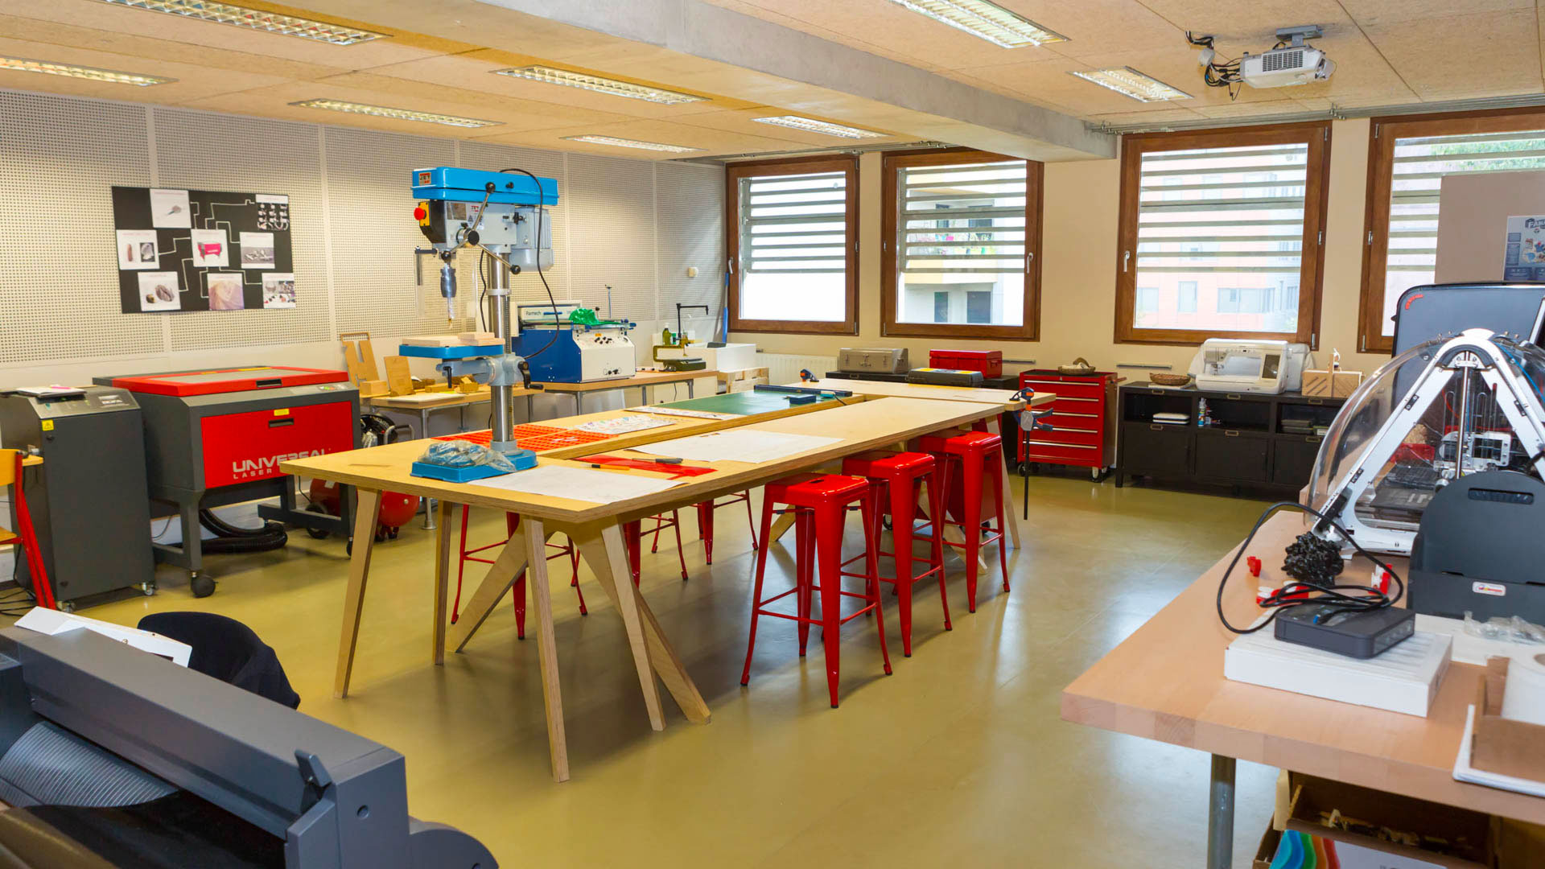
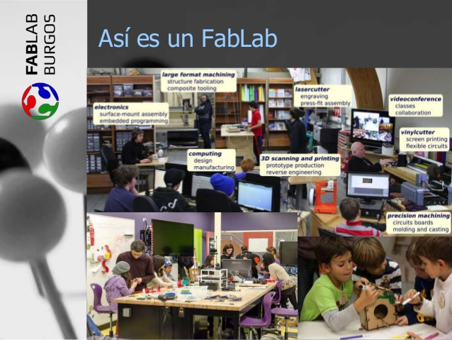
IO3: What do we need?
3D printing Work Flow: from design to 3D printed component
Where to search for help?
FabLab: a small-scale workshop offering (personal) digital fabrication, using computer-controlled tools for various materials.
Equipment generally includes:
3D printer
3-axis CNC-machine
Printed circuit board milling/etching
Laser and knife cutters
PC with design software
Trained personal can help you.
FabLabs often organise training courses.

Slide 14
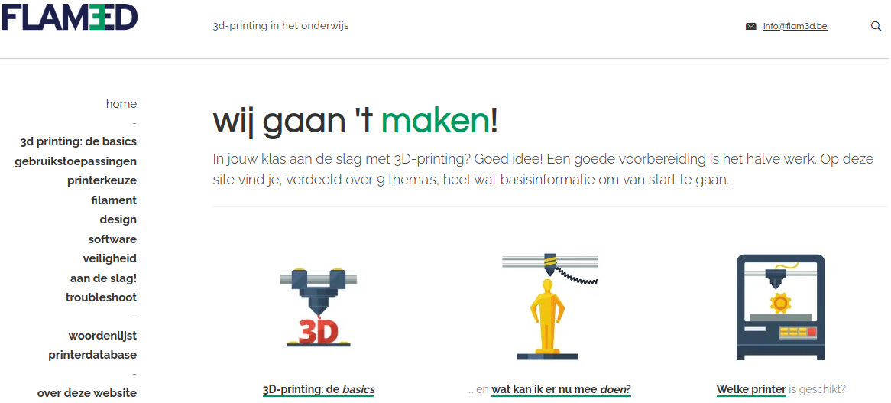
IO3: What do we need?
3D printing Work Flow: from design to 3D printed component
Where to search for help?
Training sessions/courses:
3D printer manufacturers/distributors often offer training courses (Ultimaker, Makerbot, etc.)
Spain: Education Council of the Autonomic Governments organize training courses → via Formación Docente e Innovación Educativa
Belgium: via webpage https://onderwijs.flam3d.be/
the Netherlands: via webpage http://www.3dprinter-en-onderwijs.nl/

Slide 15
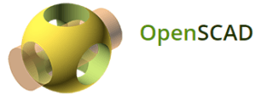
IO3: What do we need?
3D printing Work Flow: from design to 3D printed component
3D CAD DESIGN
.STL
FILE
.GCODE
FILE
3D
PRINTING
POSTPROCESSING
3D CAD SOFTWARE
3D PRINTING SOFTWARE
SLICER SOFTWARE
3D PRINTER
FINISHED PRODUCT
https://all3dp.com/1/best-free-3d-modeling-software-for-beginners/
https://all3dp.com/1/best-free-3d-modeling-software-3d-cad-3d-design-software/

Slide 16
IO3: What do we need?
3D printing Work Flow: from design to 3D printed component
3D CAD DESIGN
.STL
FILE
.GCODE
FILE
3D
PRINTING
POSTPROCESSING
3D CAD SOFTWARE
3D PRINTING SOFTWARE
SLICER SOFTWARE
3D PRINTER
FINISHED PRODUCT
https://all3dp.com/1/free-stl-files-3d-printer-models-3d-print-files-stl-download/

Slide 17
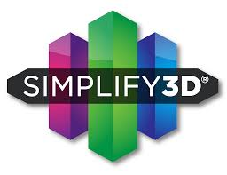
IO3: What do we need?
3D printing Work Flow: from design to 3D printed component
3D CAD DESIGN
.STL
FILE
.GCODE
FILE
3D
PRINTING
POSTPROCESSING
3D CAD SOFTWARE
3D PRINTING SOFTWARE
SLICER SOFTWARE
3D PRINTER
FINISHED PRODUCT
https://all3dp.com/1/best-3d-slicer-software-3d-printer/

Slide 18
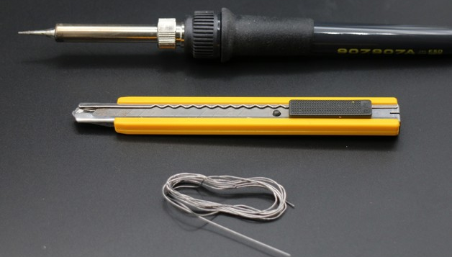
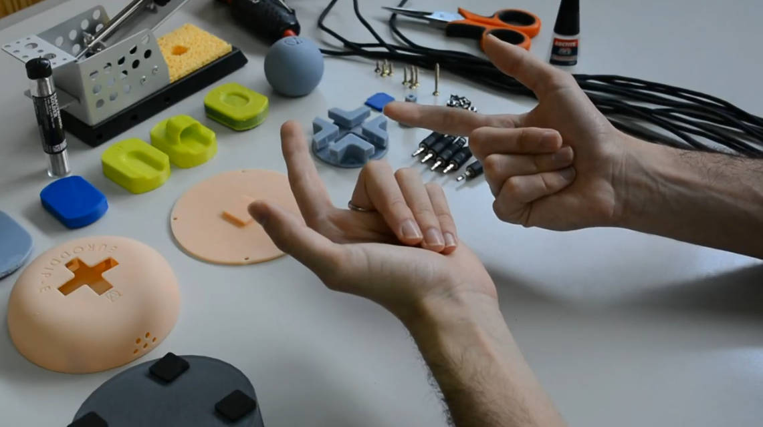
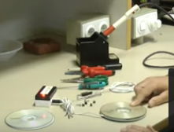
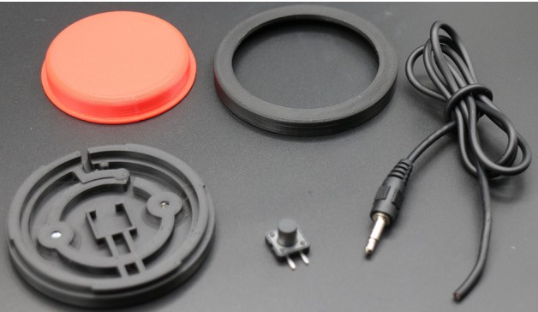
IO3: What do we need?
Depending on the design: assembly materials, assembly tools, handy hands
Handyman FabLab, friends, colleagues, parents council, etc.

Slide 19
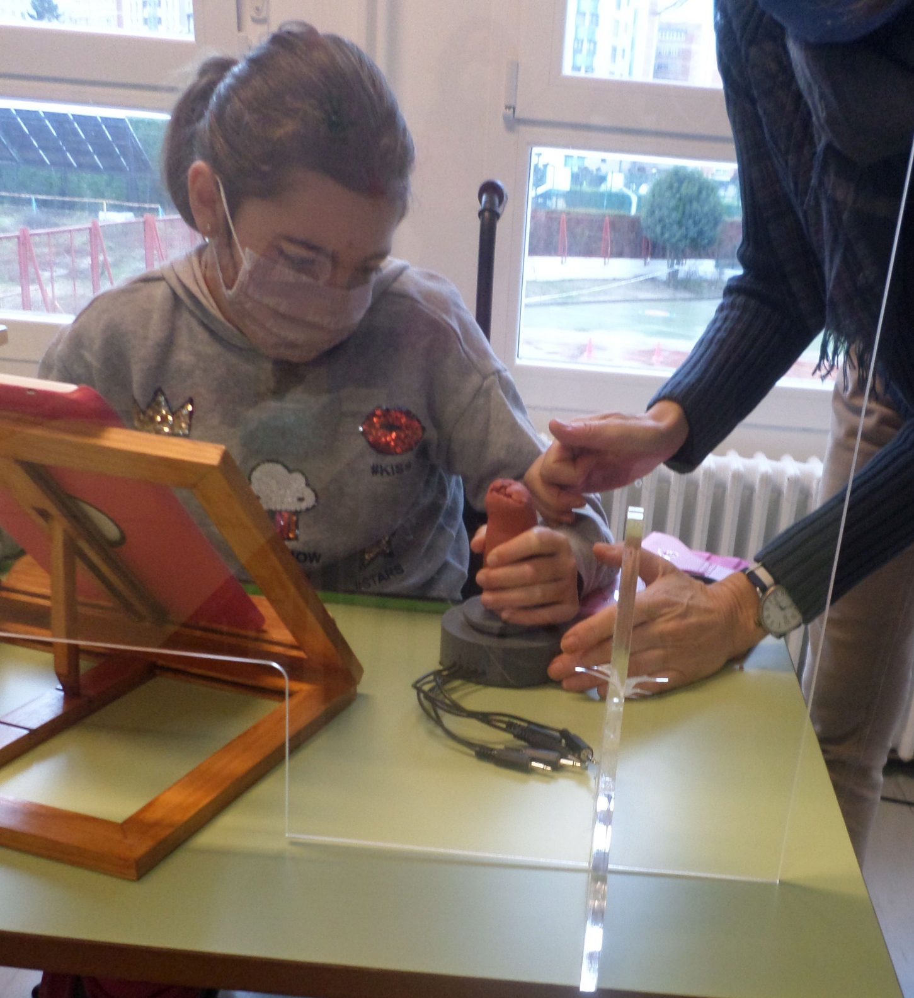
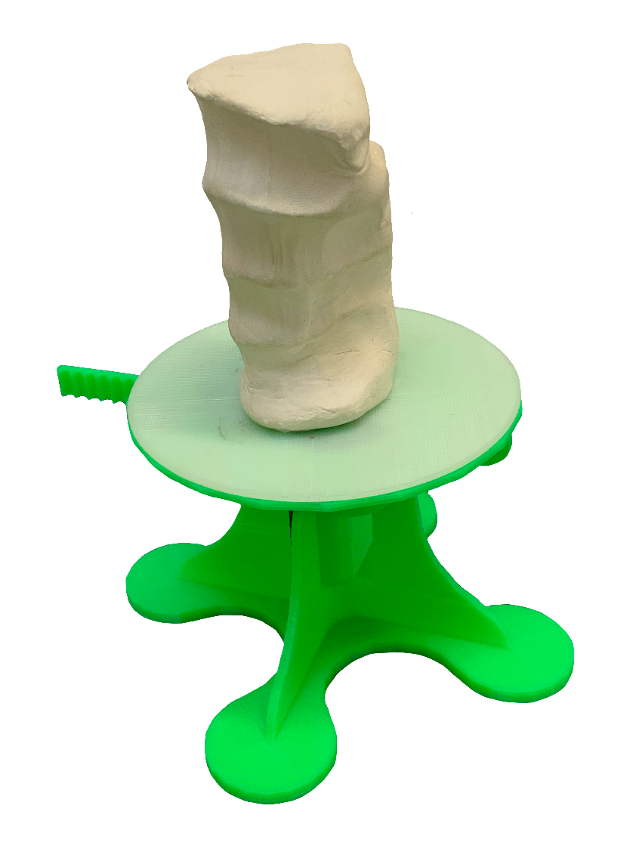
IO3 Personalized input devices
Personalize
Photogrammetry
Notes:
Use some clay and make an imprint of the part you want to personalize. Then you can scan the imprint and convert it into a 3D printable design using photogrammetry.

Slide 20
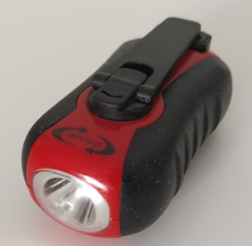
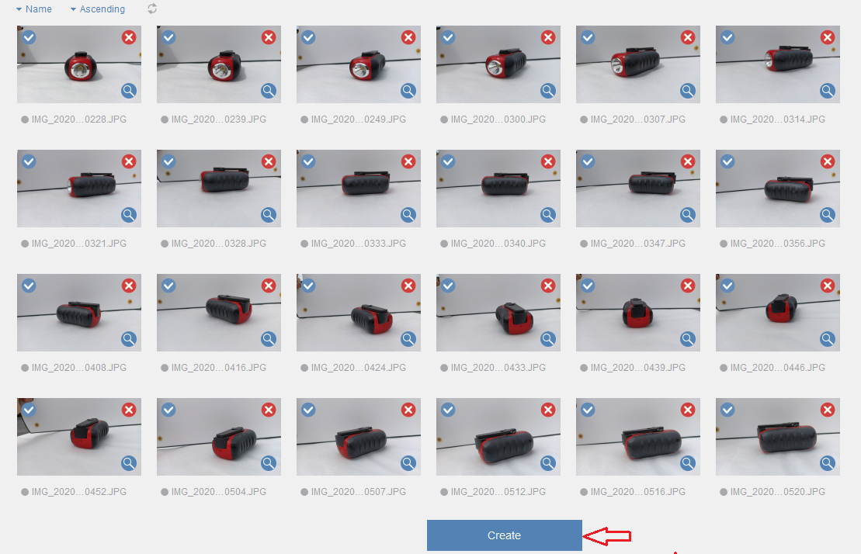
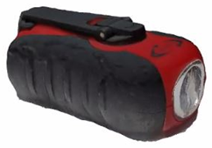
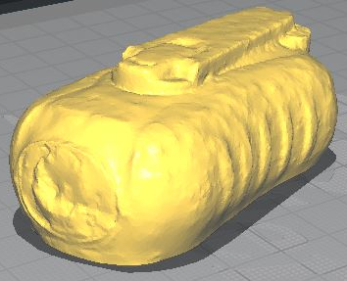
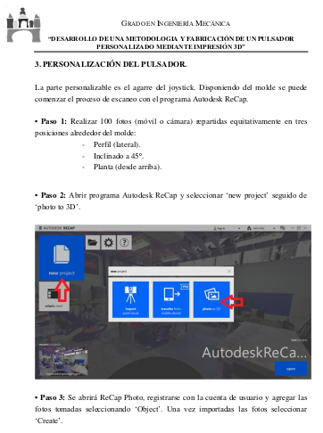
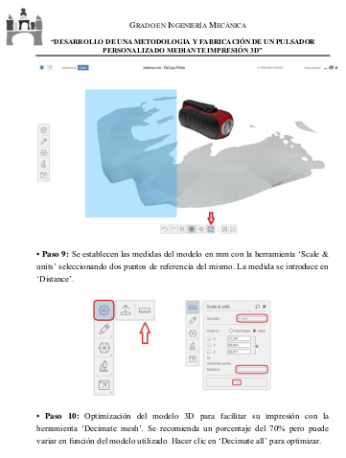
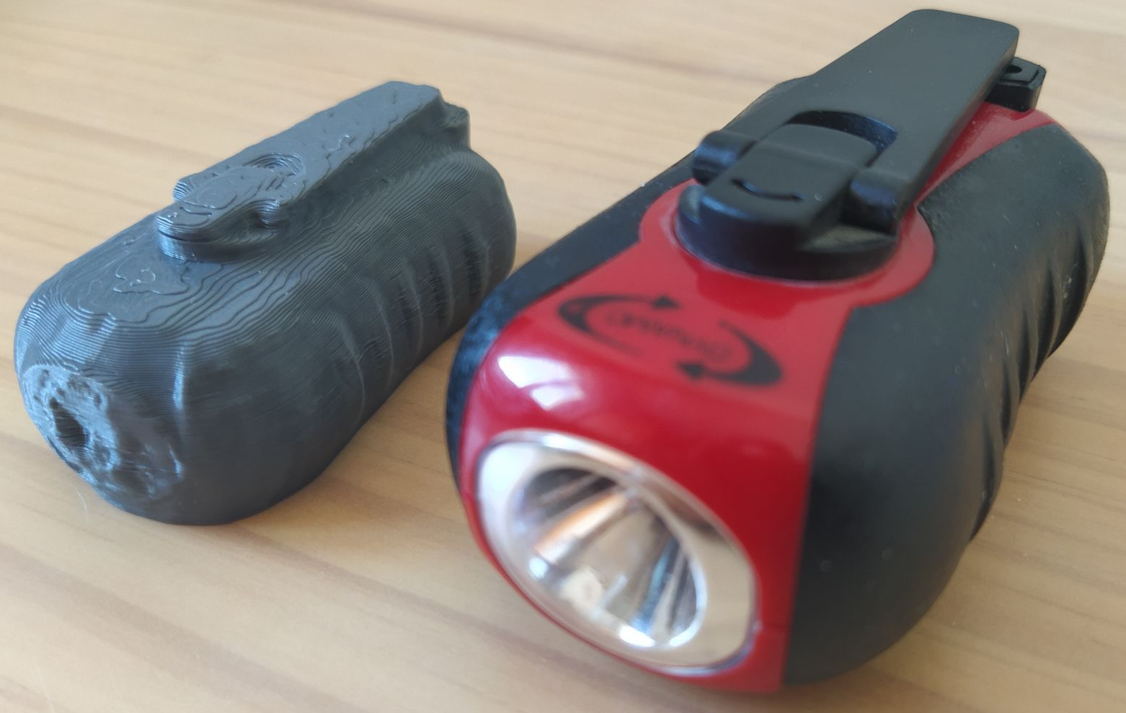
IO3 Personalized input devices
Personalize
Photogrammetry
Photos from different angles
Scanned object
STL file
Original object
Available at:
https://euroddip-e.eu/
Notes:
So, how does photogrammetry work? Example: flashlight.

Slide 21
IO3 Personalized input devices
Personalize
Photogrammetry
https://all3dp.com/1/best-photogrammetry-software/
SOFTWARE | COST
Autodesk ReCap | - 285 €/year. - 1 year free (educational license)
Agisoft Metashape | - Professional Edition 3.068 €. - Standard Edition156,97 €.
AliceVision Meshroom | Free.
Pix4D | From 32,50 € to 306,25 € per month.
PhotoModeler Technologies | Variable price according to permanent, renewable or monthly license and version.
CapturingReality | From 19,90 € to 15.000 €.
Regard3D | Free.
Trimble Inpho | Free.
WebODM | One-time fee: 49,99 €
3DF Zephyr | - Limited 50-images free version. - Paid version ranges from 149 € to 3.900 €.

Slide 22
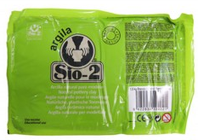
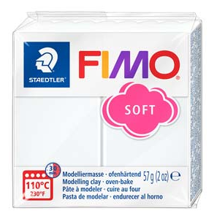
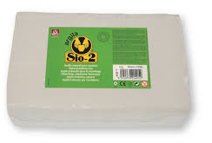
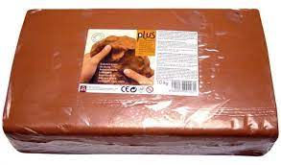
IO3 Personalized input devices
Personalize
Photogrammetry
If the person for whom you can to personalize a device has little strength → test different kind of clays with different hardness.
Inexpensive and can be found in “Arts and Crafts”, toy, DIY, or web stores.

Slide 23
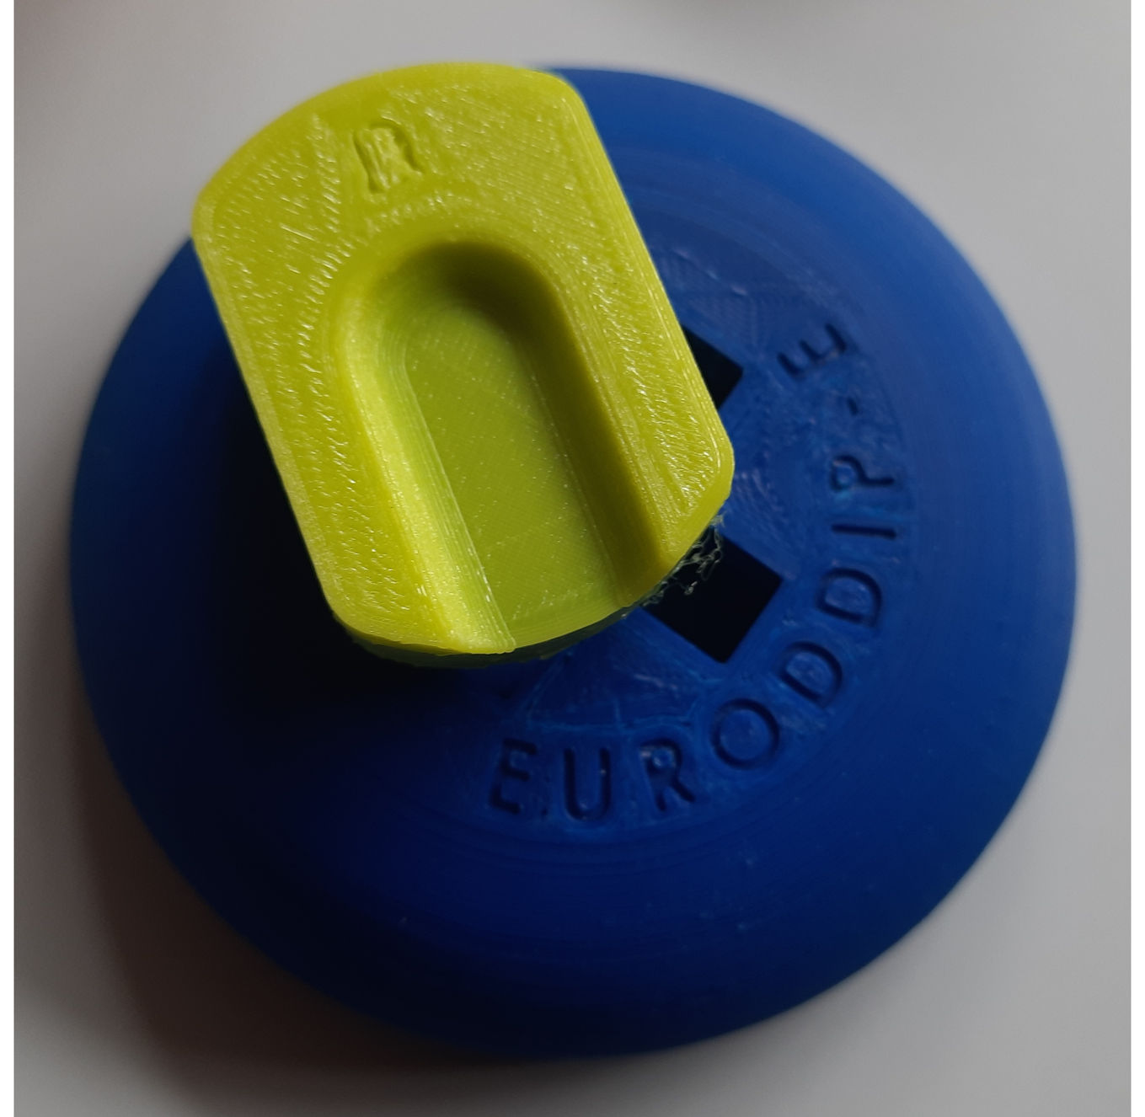
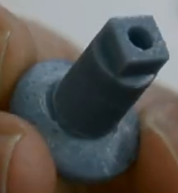
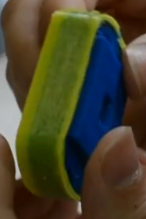
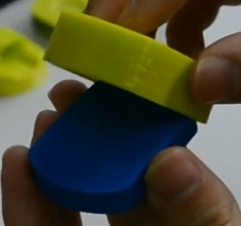
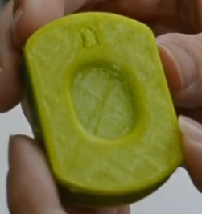
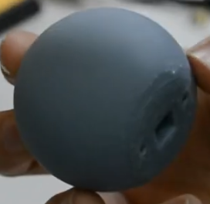
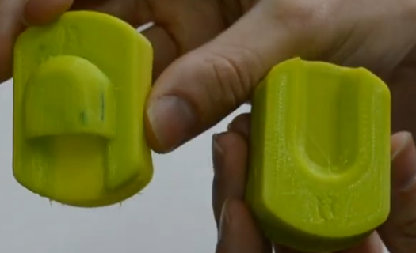
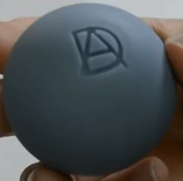
IO3 Personalized input devices
Joystick / Push Buttons
3D model is available in the 3D Design Repository
https://www.thingiverse.com/thing:4873369
Thingiverse → Search Thingiverse: “euroddip” → Joystick, V2
Thingiverse
TPU
TPU
ABS
ABS

Slide 24
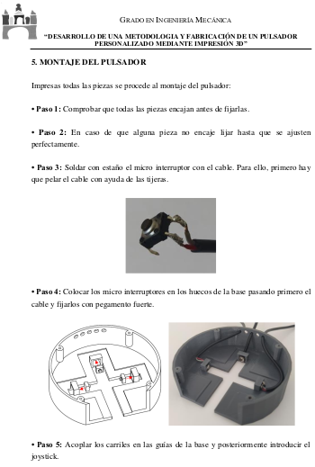
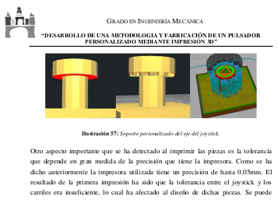
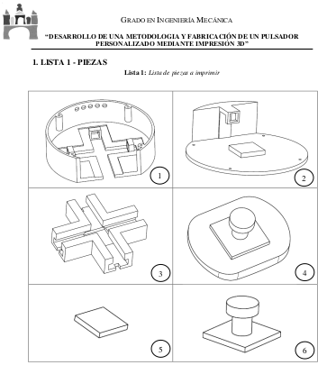
IO3 Personalized input devices
Joystick / Push Buttons
3D model is available in the 3D Design Repository
https://www.thingiverse.com/thing:4873369
Thingiverse → Search Thingiverse: “euroddip” → Joystick, V2
Thingiverse
TPU
Instruction video
Instruction manual
Available at:
https://euroddip-e.eu/
ABS

